Slide 1
Welcome to coding class

Slide 2
What is programming?
Giving instructions to a computer
Make it do something
Examples
Setting timer on microwave
Setting an alarm clock
Changing settings on smartphone

Slide 3
What are programming languages?
Allow you to give instructions to a computer using code
Examples
Scratch
Javascript
Python
Use human language
Instructions must be exact (no typos, use keywords)

Slide 4

Python
Programming language
Easy to learn and write
Used by large companies like Google and NASA
Used for:
Games
Web and software development
AI/Machine learning
Scientific research

Slide 5
Installing Python
python.org/downloads

Slide 6
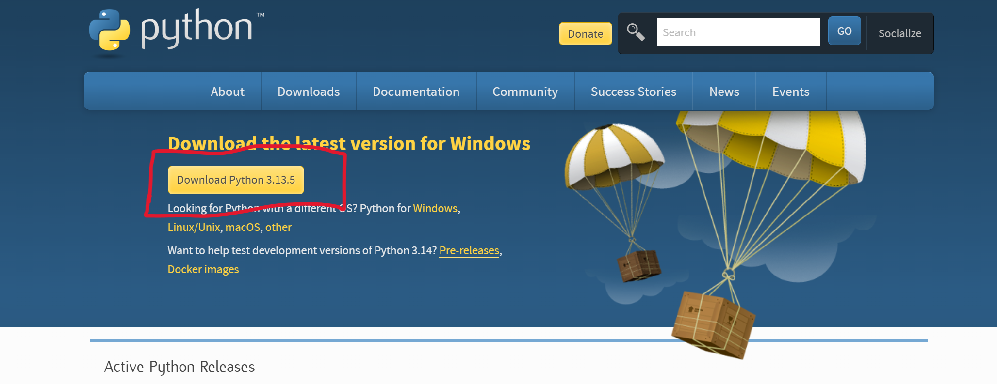

Slide 7
Using IDLE
After download finishes, find IDLE on your computer
IDLE is a Python Shell for running code
Open IDLE and click File and New File
This will open code editor

Slide 8
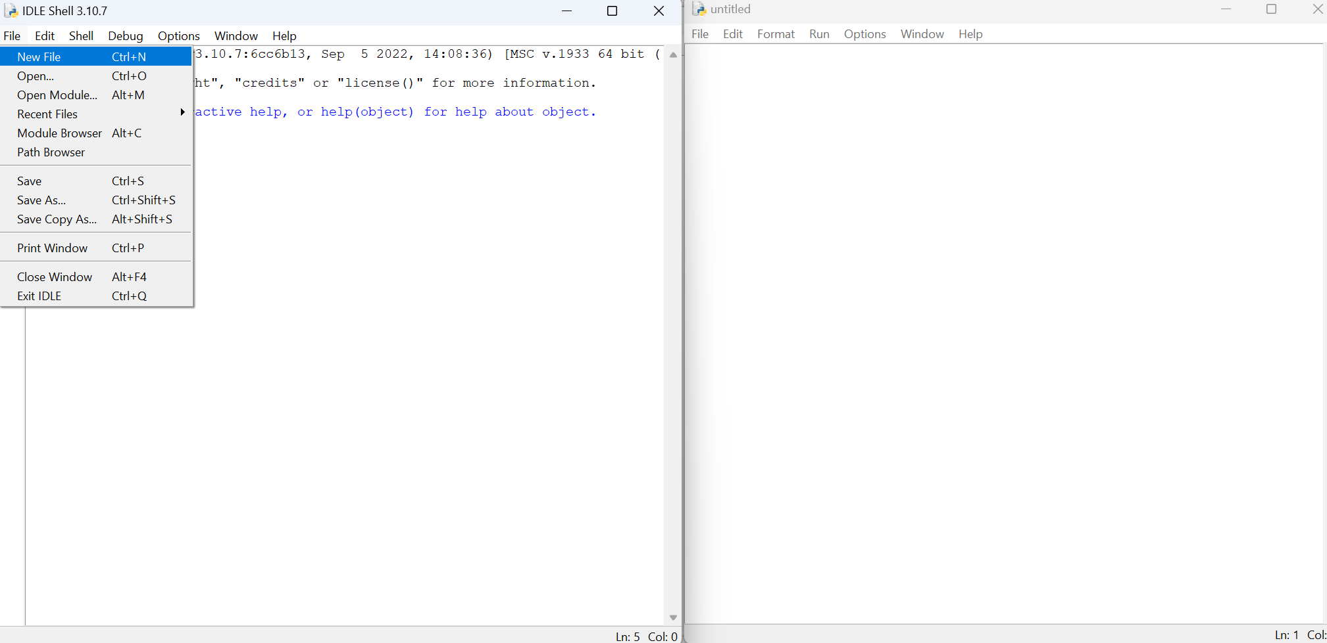

Slide 9
First program – Hello World
print keyword – prints output to terminal
01
print(“Hello, World!”)
02
Type code into code editor
03
Save program as hello.py, then click Run
04

Slide 10
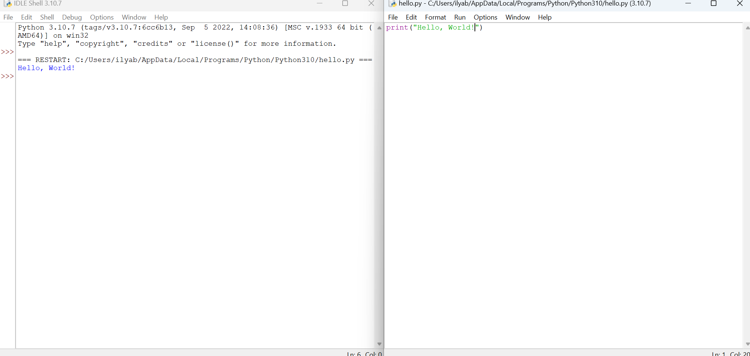

Slide 11
Parentheses () contain message you want to be printed
Putting it in quotes makes it a string datatype
Strings contain text

Slide 12
Try changing the message inside the string
Ex. Make the program say hello to you
Save and run when finished

Slide 13
Try printing multiple messages
Your name
Your age
Fact about you

Slide 14
print(“My name is John”)
print(“I am 12 years old”)
print(“I like to draw”)

Slide 15
Fixing errors
Try removing the quotes or parentheses and see what happens when you run the program

Slide 16
Code syntax needs to be exact, otherwise it will generate errors

Slide 17
Printing numbers
print(5)
Numbers are an int datatype (integer)
Don’t need quotes since they are treated as numbers rather than text

Slide 18
Try printing different numbers

Slide 19
Mathematical operations
Can use print statement to solve equations and print solution
print(5+2)
print(8-3)
print(10*4)
print(12/2)

Slide 20
What will be output if you put equation in quotes?
print(“5+2”)

Slide 21
Try these. What will be output of each one?
print(“5”+”2”)
print(“5” + 2)
print(“5”+”Hello”)
print(5 + ”Hello”)
Print(“Hello” + “World”)

Slide 22
Comments
print(5+2) #prints solution to equation
# symbol used to leave comments in code
Comments are meant to make your code easier to read
Don’t affect how code is run

Slide 23
Review
print keyword prints output to terminal
Dataypes
String- used for text. In quotes.
Int – used for numbers. No quotes.

